Slide 1

In House pipeline: NG-Tax
Validation based on controls
Open & reproducible microbiome data analysis spring school
Wageningen, The Netherlands, May 28-30, 2018
Gerben DA Hermes, PhD
Laboratory of Microbiology,
Wageningen University & Research

Slide 2
Tested parameters
Primer pair
Barcoding strategy
Chimera filtering
Filtering parameters
OTU picking
Database
Etc...
And try to come up with an ‘optimal’ combination of each

Slide 3
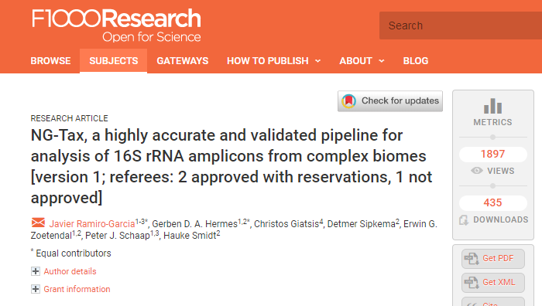
In house analysis pipeline: NG-Tax

Slide 4
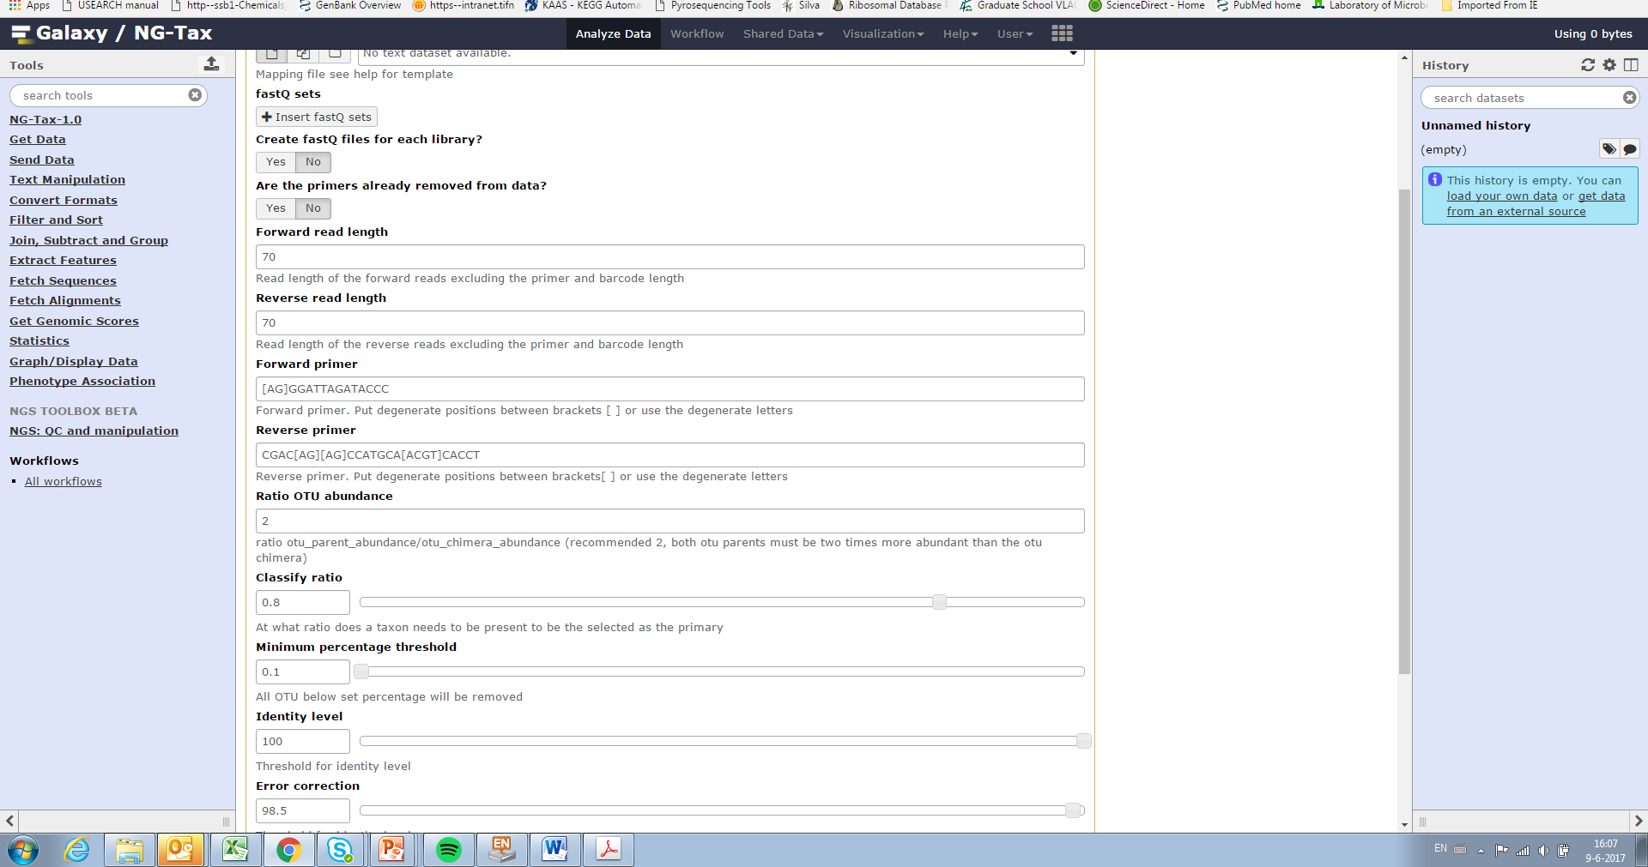
NG-Tax analysis & settings Galaxy interface

Slide 5
Validation: Positive controls/Synthetic or Mock communities
Qualitative & quantitative
1
2
3
4
54 species
32 genera
7 phyla
Resolution
How low can we go

Slide 6
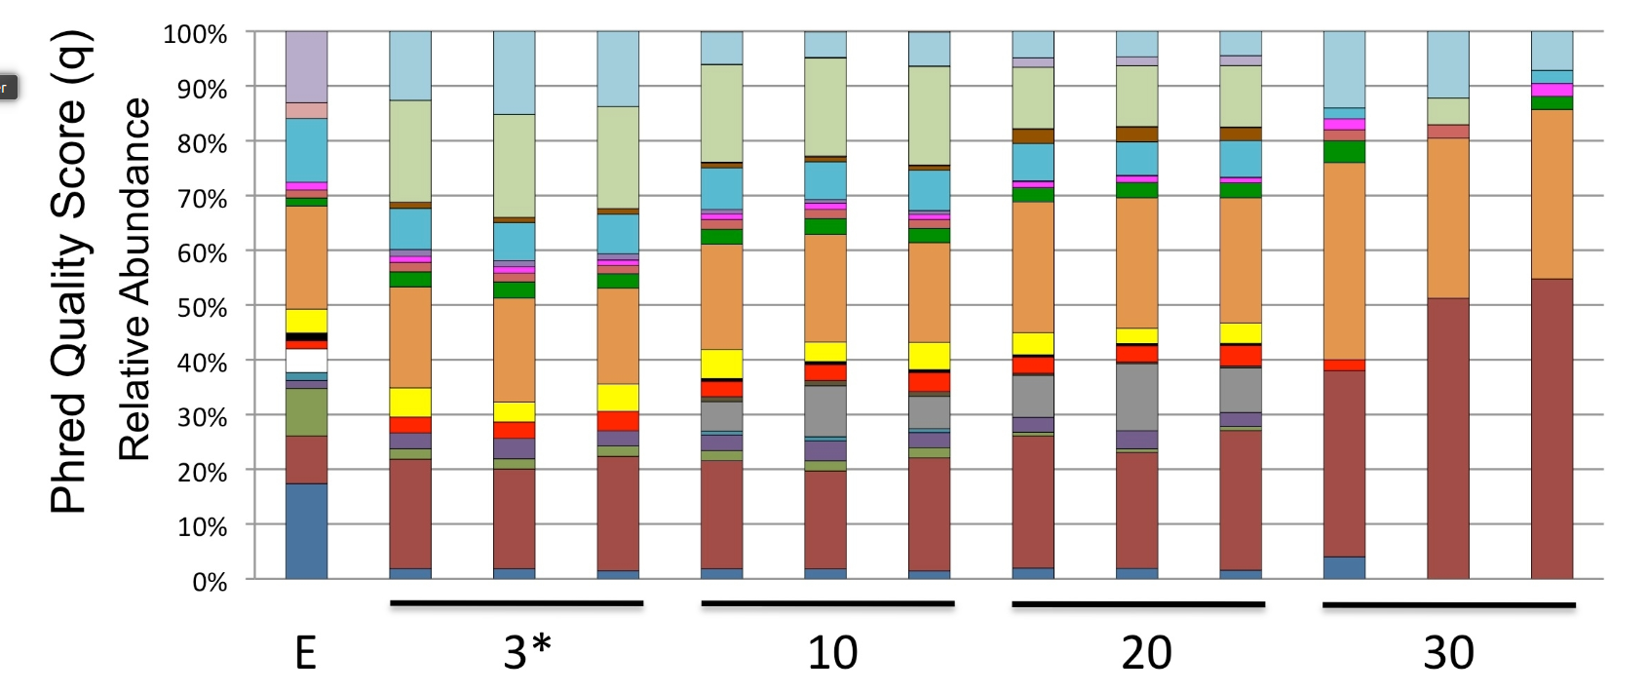
Effect of quality filtering
Bokulich 2013, Quality-filtering vastly improves diversity estimates from Illumina amplicon sequencing. Nat methods. supplementals

Slide 7
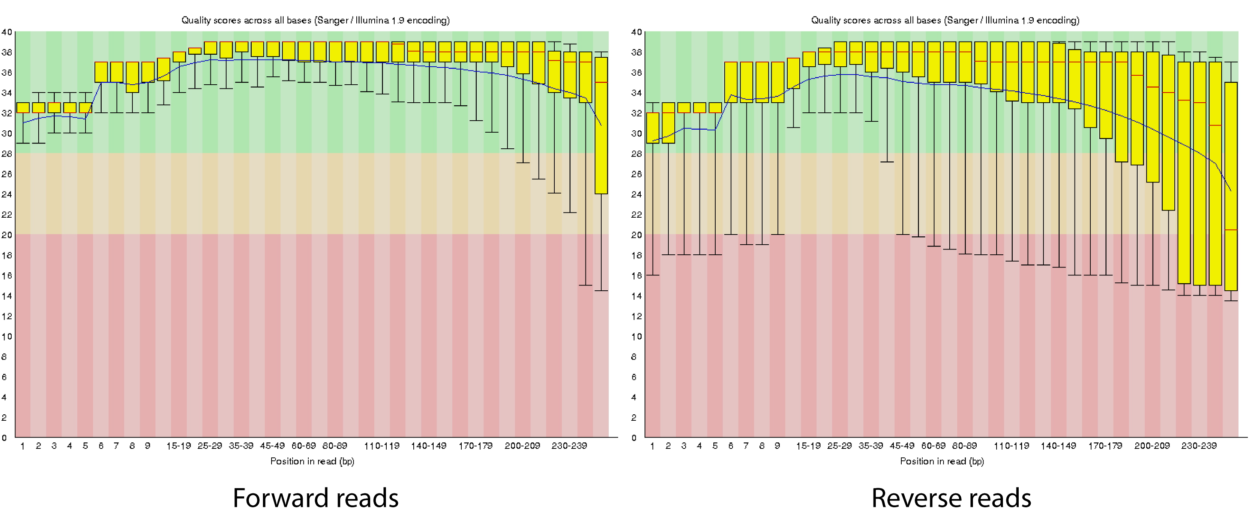
Settings optimization
No quality filtering based on phred score
Filter by abundance -> high quality
“QC” = demultiplexing (matching valid barcodes)
‘Short’ reads: 2x70nt (enough for identification) = less room for error.
Phred 10 = 90% accuracy, 30 99.9%

Slide 8
OTU classification: Classify ratio

Slide 9
95% sequence similarity: genus level Based on full length 1500nt SILVA alignment
95%
100%
99%
95% sequence similarity: genus level
Same sequence/different classification
‘choose’?
SILVA: Blautia/Faecalibacterium

Slide 10
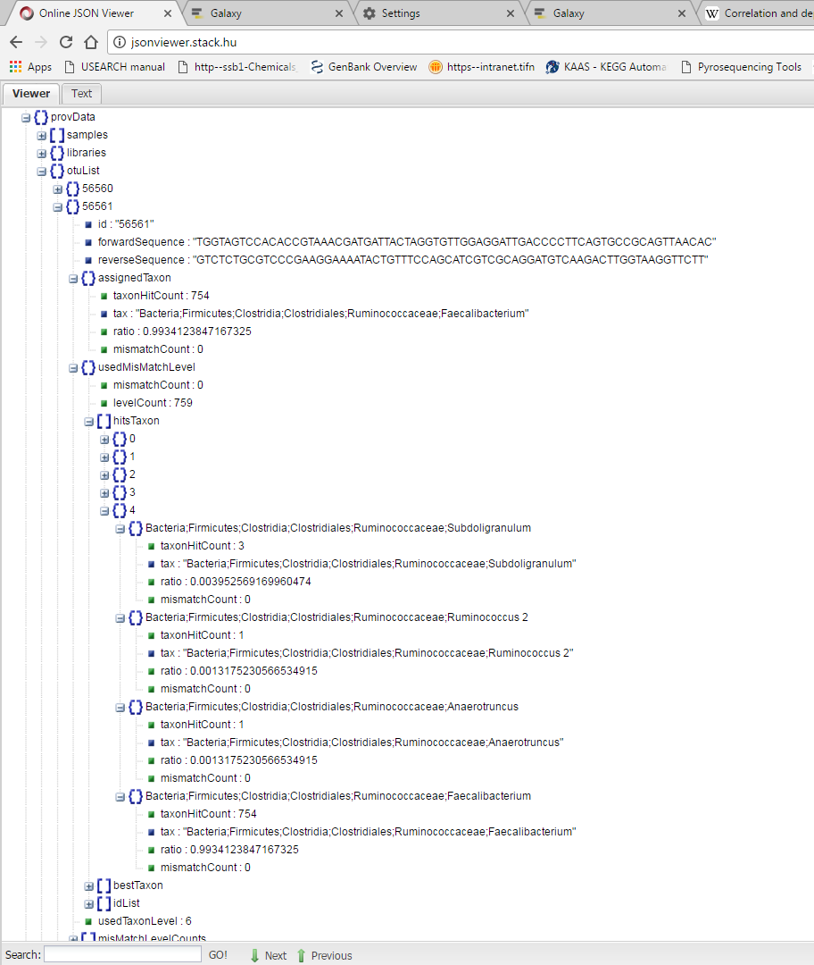
Real example: very clear
Nr hits that are Feacalibacterium
100% match in the SILVA DB
nr hits with 100% match in the SILVA DB
All hits in the SILVA DB with 100%
99.34% of the 100% matches of that sequence (OTU) in the SILVA database are Feacalibacterium

Slide 11
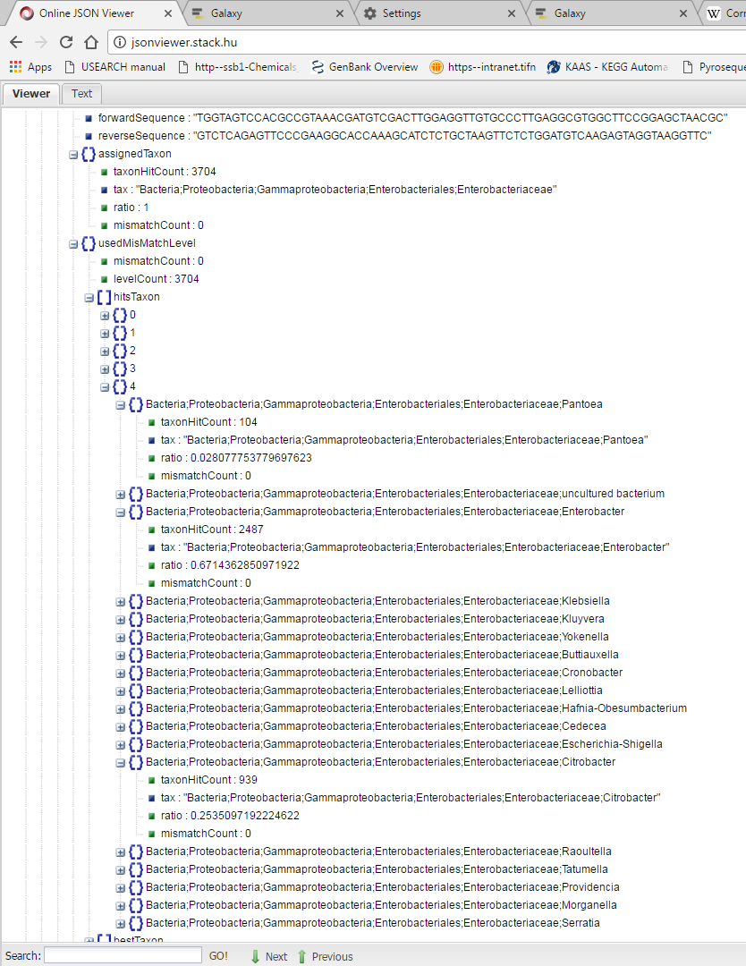
Real example: less clear
Assigned:
Enterobacteriacaea
2.7% Pantoea
67% @100% match with 3704 hits -> back to family
25% Citrobacter

Slide 12
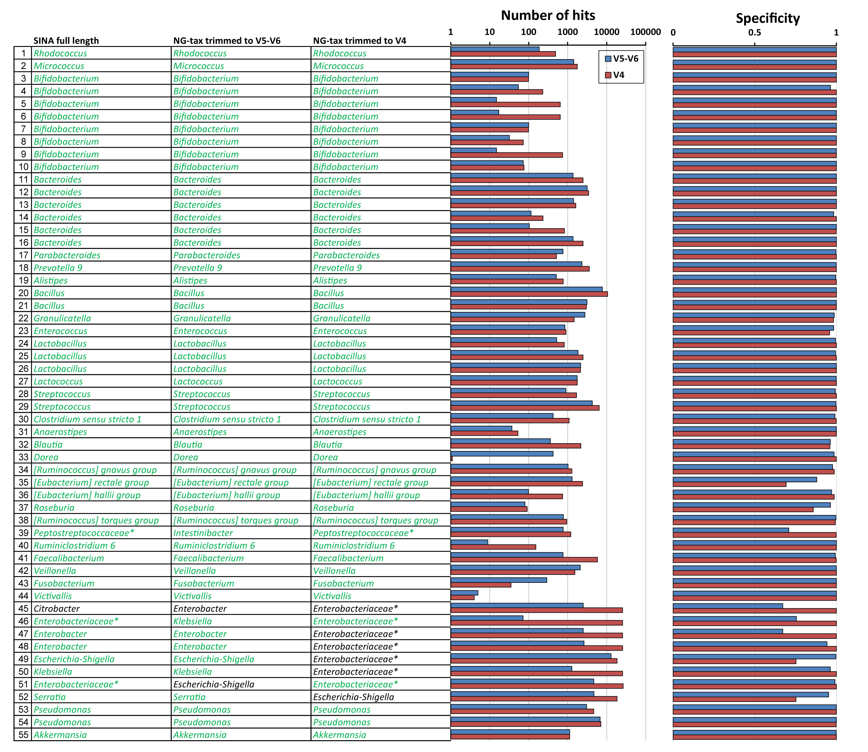
NG-Tax classification accuracy & confidence 2x70nt information

Slide 13
Validation
Sources of error/noise:
4 different synthetic community types (each in triplicate)
2 different variable regions V4, V5-V6
2 primer pairs (515F-806R, 784F-1064R)
25-35 PCR cycles
7 libraries
3 different sequencing runs

Slide 14
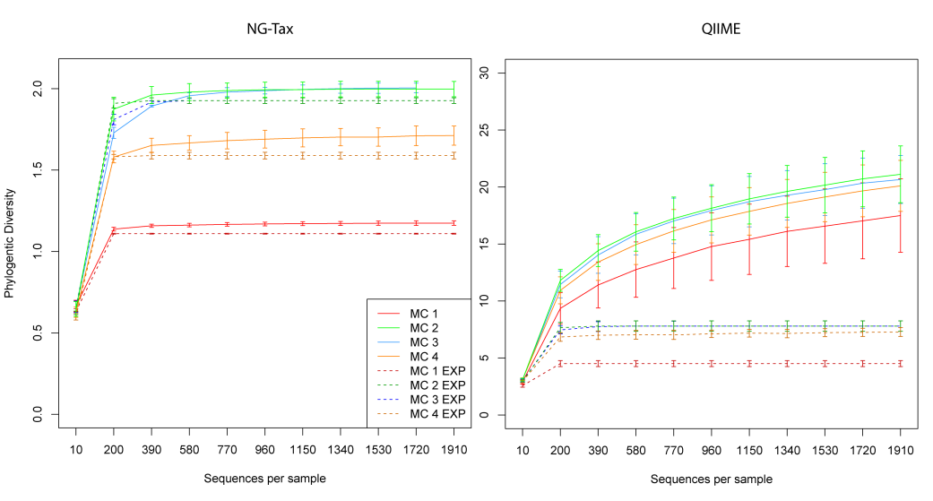
NG-Tax performance: alpha diversity
Rarefaction plots

Slide 15
NG-Tax performance: beta diversity

Slide 16
NG-Tax performance: beta diversity

Slide 17
Retain or retrieve the relevant high resolution
biological information despite high noise levels
Independent of
primer type/variable region
Sample diversity/complexity
Sequencing run

Slide 18
Biom (OTU table)

Slide 19
Data interpretation: NG-Tax
Reads/OTU -> confidence
~3 reads not very confident. 30.000 reads very confident
Classification ratio 0.8, maybe check
Preferably at genus level, OTUs contain too much risk/error, unless the OTU is very ‘clean’
Preferably use phylogenetic information because OTU based methods are very sensitive to noise
Check classification of interesting OTUs
Classify Nas using whatever method (blast is ugly)

